Slide 1
SEPI Society for the Exploration of Psychotherapy Integration Annual meeting 2022

Slide 2
Göran Högberg MD, PhD Mood regulation and memory reconsolidation as principles of change in psychotherapy. Example: MR-CBT (Mood regulation focused cognitive behavioural therapy)

Slide 3
Mood regulation in depression

Slide 4
Angry and dysphoric affect last longer, are difficult to leave Periods of happy affect shorter, and difficult to keep But note also positive affect exists – a problem of regulation Sheeber, Allen, Leve, David, Shortt, Katz. Dynamic of affective experience and behaviour in depressed adolescents. Child Psychology and Psychiatry 2009;50:1419-1427.

Slide 5
Pessimistic bias comes with depressive symptoms. A negative bias of the future is a memory of such a fantasy. So this also is about memory. Strunk, Lopez, deRubeis. Depressive symptoms are associated with unrealistic negative predictions of future events.

Slide 6
There is a bridge, a linking of affective states with episodic memories. At times very evident, at times more subtle, like only traces of memories surfacing.

Slide 7
Thus there is a rationale for changing the reactions to memories when we want to influence mood regulation

Slide 8
old concept event short term memory –long term memory after consolidation by new protein synthesis- stored-not changed

Slide 9
new concept Event rememberance + activation of that memory - destabilized upon activation- needs reconsolidation to stabilize again. Within a time frame, hours. Changes, new learning is possible!

Slide 10
Memory reconsolidation 1973 Spear Revival around the turn of the century, Nader, Ledoux, Nadel, Lee, Hardt, Walker, Forcato, Schiller.

Slide 11
”It takes little courage and imagination to assert that reconsolidation exists as a time-dependent associative process that is initiated when a consolidated memory is activated.” Karim Nader & Oliver Hardt. A single standard for memory: the case for reconsolidation. Nature Reviews Neuroscience 2009;10:224-234.

Slide 12
The scientific presentation of the concept memory reconsolidation is given in this collection volume 2013. ISBN: 978-0-12-386892-3

Slide 13
The implications for psychotherapy of the concept memory reconsolidation is presented in this book, a special issue of the journal The Neuropsychotherapist 2015. ISBN : 13:978-1506004341

Slide 14
Development of a therapy based on mood-regulation and memory reconsolidation

Slide 15
I worked at BUP Stockholm Child and Adolescent Clinic as a child psychiatrist. In order to be able to help suicidal and selfharming youth that were not helped with standard medication/therapy we developed between 1995 and 2014 a new integrative approach that was described in series of papers

Slide 16
Högberg, Hällström. Active Multimodal Psychotherapy in children and adolescents with suicidality: description, evaluation and clinical profile. Clinical Child Psychology and Psychiatry 2008;13:435-448. Case-series. 14 depressed suicidal youth. Mean nr sessions 17. Good results, GAF less than 50 before, about 75 after treatment and at two year follow up. The extent of untold undiagnosed trauma, understood during treatment, 64 % was noted, also the importance to access and treat the symptomatic state. The mood map was presented.

Slide 17
The mood map charting moods, feelings

Slide 18
First instruction ”Put a symbol of yourself, the part of you that is present in all your moods in the centre. Then chart your recent and present moods, feelings states, and show how they are related and transformed.”

Slide 19
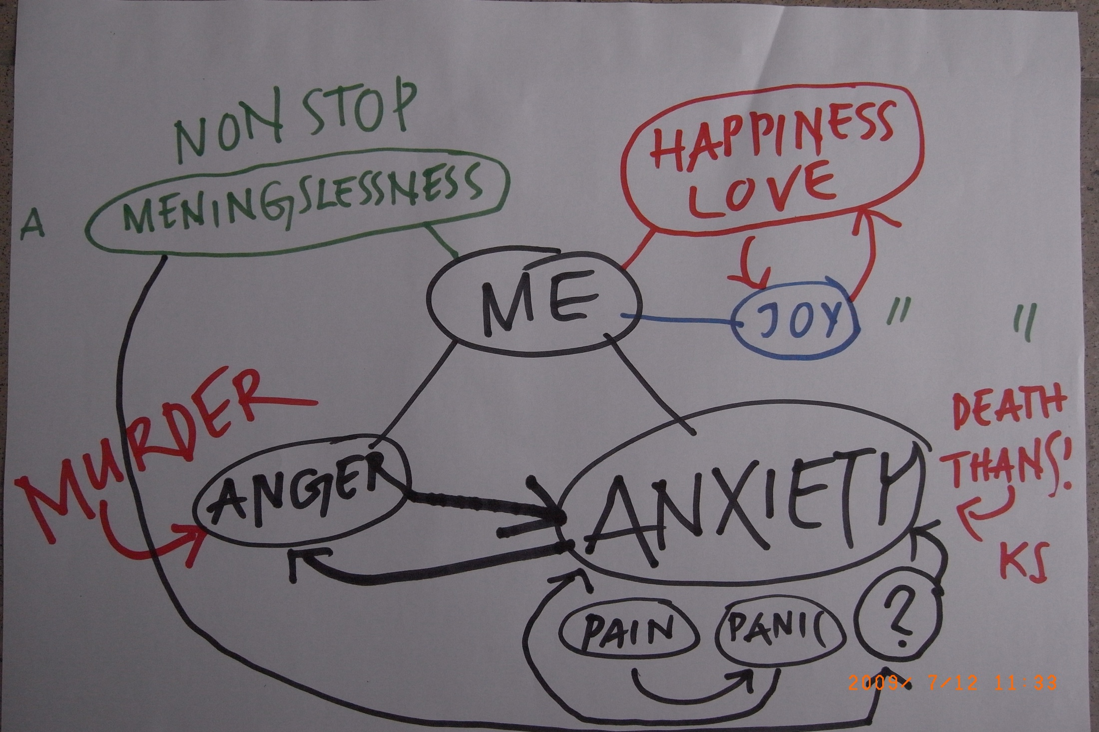

Slide 20
Second instruction ”Now chart how you would like your moods, feelings, to exist in the future, in a positive fantasy.”

Slide 22
Third instruction ”and finally, when you look at the present state and the wished for future, what is needed, what change do you envision?”

Slide 23
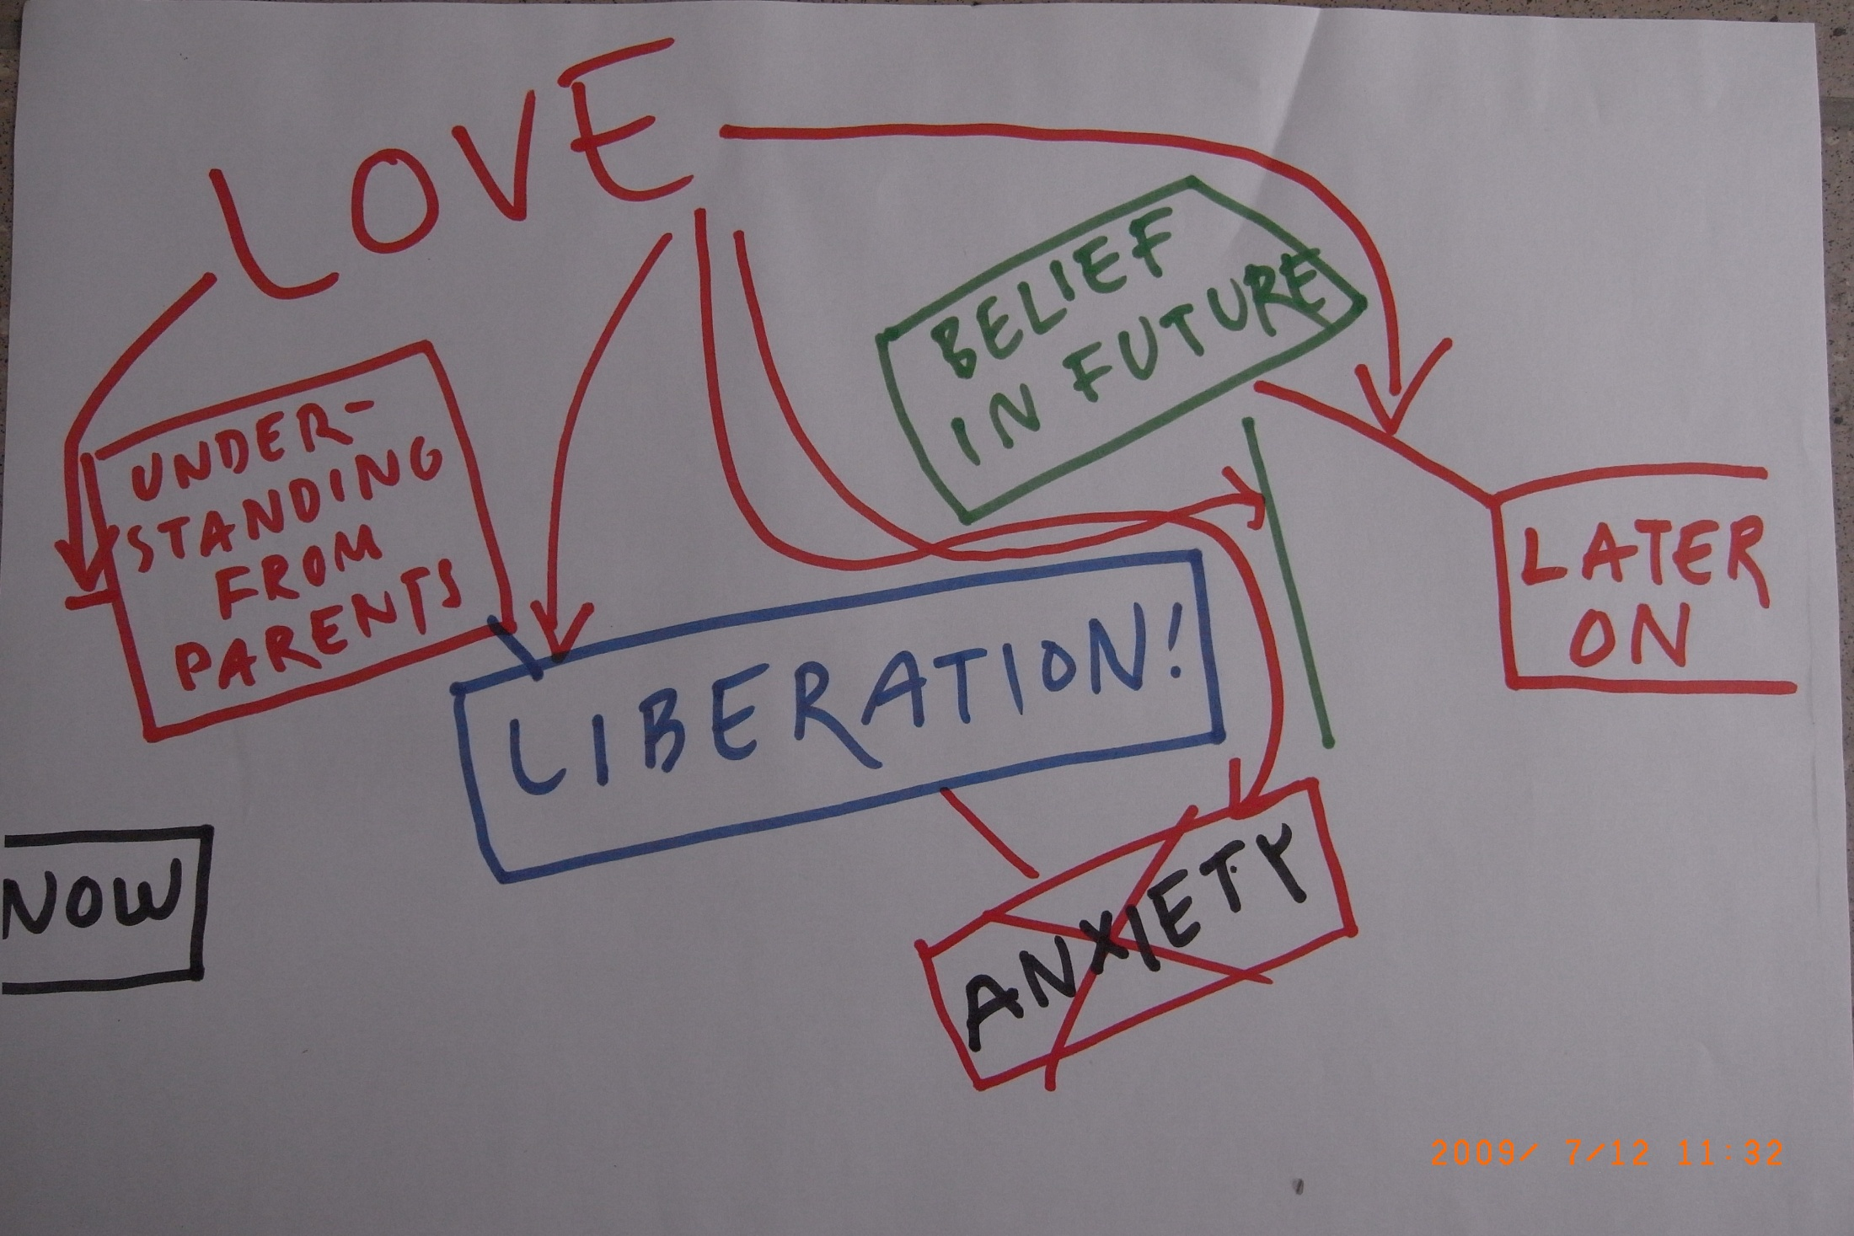

Slide 24
Högberg, Nardo, Hällström, Pagani 2011. Affective psychotherapy in post-traumatic reactions guided by affective neuroscience: memory reconsolidation and play. Psychology Research and Behavior Management;8:87-96. The question: how can cognitive/affective neuroscience inform the mechanism of change in psychotherapy?

Slide 25
The answer: memory reconsolidation

Slide 26
Högberg & Hällström. Mood regulation focused CBT based on memory reconsolidation, reduced suicidal ideation and depression in youth in a randomised controlled study. Journal of Environmental Research and Public health 2018;15:921 A RCT with 27 depressed adolescent, also with increased suicidality, median nr of sessions 12. The method is now named mood regulation focused cognitive behavioural therapy, MR-CBT, because clearly the protocol entails systematic exposure to two different feelings during the session. But the method is also associative. There was after treatment a significant difference in suicidal ideation, and near significant in the depression scale Mood and Feelings Questionnaire favouring MR-CBT.

Slide 27
The aim of the treatment with MR-CBT is to significantly weaken the negative affect combined with traumatic och troubling memories.

Slide 28
If we aim at diminish the negative affect associated with a personal memory we need to activate, create this associated emotion! Otherwise it cannot be reconsolidated.

Slide 29
This means that the client might become fearful, angry and getting dangerous impulses!

Slide 30
How to solve this dilemma!

Slide 31
Safety protocol: Embedded in safety and security. At start and the end of the session positive feelings should be activated.

Slide 32
Role of the therapist: also a feel-good coach, helping the client to feel good and safe in the session

Slide 33
Sleep deprivation aggravates difficulties in both cognition and mood regulation

Slide 34
Always start to improve sleep: ruminations, flashbacks, nightmares, inability to relax

Slide 35
In this work with sleep, central components are breathing, relaxation and practice to switch between thoughts and the focus on breathing. There is thus practice in thought-regulation as a form of mood-regulation

Slide 36
Session theme An agreed theme or material that has arrived in an associative process.

Slide 37
Different techniqes could be applied. Most commonly I use mental imagery, visualizations, the client being in a relaxed state exploring inner mental experiences. Quiet breathing is central. The therapist does not need to know all about the content. What matters is the activation of the memory.

Slide 38
In memory the same areas of the brain are activated as during the original encoding Damasio. Time-locked multiregional retroactivation: a systems level proposal for the neural substrates of recall and recognition. Cognition 1989;33:25-62.

Slide 39
This principle is used in MR-CBT in order to achieve activation of a memory/feeling

Slide 40
An episodic memory could be replayed with successive different focus such as: 1. Perception, sensory system, seeing, hearing, proprioception. 2. Autonomic reactions, feelings, experience in the body. 3. Thoughts. 4. Motor impulses, potential actions.

Slide 41
Session structure: First phase: activation of positive emotion a. Breathing, moving between thought-system and focus on breathing b. Safe-place exercise. c. Positive recent experience visualization

Slide 42
Second phase Dealing with negativ affect, negative memories, problems. Activation by repeatedely activate the memory along different lines as described Then in phantasy explore a different positive version of the event and finally an inner film using words to communicate the experience to a recipient like an audience or person.

Slide 43
Third phase This phase is for closure and integration a. Activate the feelings of safety, control and peace from the safe- place exercise b. Make a positive future-projection for the incoming week. c. Rest d.Reflect on the session together with the therapist

Slide 44
Protocol summary plus-minus-plus

Slide 45
Dissociative depression, longstanding depressive mood-shifts as long flashback-states, based on previous trauma. Compare with dissociative, reactive psychosis. Psychotic symptoms formed by longlasting shattered and dissociated flash-backs. Sar V, Akyüz G, Öztürk E, Alioğlu F. Dissociative Depression Among Women in the Community, Journal of Trauma & Dissociation 2013, 14:4, 423-438 Van der Hart O, Witztum E, Friedman B. From hysterical psychosis to reactive dissociative psychosis. Journal of traumatic Stress 1993;6(1):1-13

Slide 46
This client with recurring depressive periods with suicidality draws the following mood-map

Slide 48
Asked in what mood the depression and suicidality did reside, the client showed this.

Slide 50
This could be considered a dissociated mood-state, that is in fact trauma-related but hidden and coming to the surface only in parts such as stiffness, suicidal ideation etc. Often I encounter such a combination, which I think can be labelled dissociative depression.

Slide 51
This can be well treated with MR-CBT, both on line, with telephone sessions and ordinary treatment sessions. The safety resulting from the practice of breathing and positive mental imagery makes it possible to access the traumatic content that was present in the dissociated state.

Slide 52
In summary: I propose that mood-regulation change by the mechanism of memory reconsolidation is both transdiagnostic, suitable for a variety of diagnoses, as well as transmodal, fitting different therapeutic modalitites. Thus it might be relevant for the theme of this conference: ”toward a common core”

Slide 53
As an adolescent suggestes as the way forward

Slide 55
Attached is an english version of the protocol. It is free to use and develop. Thanks for listening! Göran Högberg goran.hogberg@gmail.com

